Slide 1
What Are Those!
A drawing game
Hriday Raj, Thomas Sato, Evan Wylie

Slide 2
Why? (lore)
Drawing games grew in popularity during the pandemic
Skribbl.io
Gartic Phone
However, these games require online connectivity.
We made a 1-device version…

Slide 3
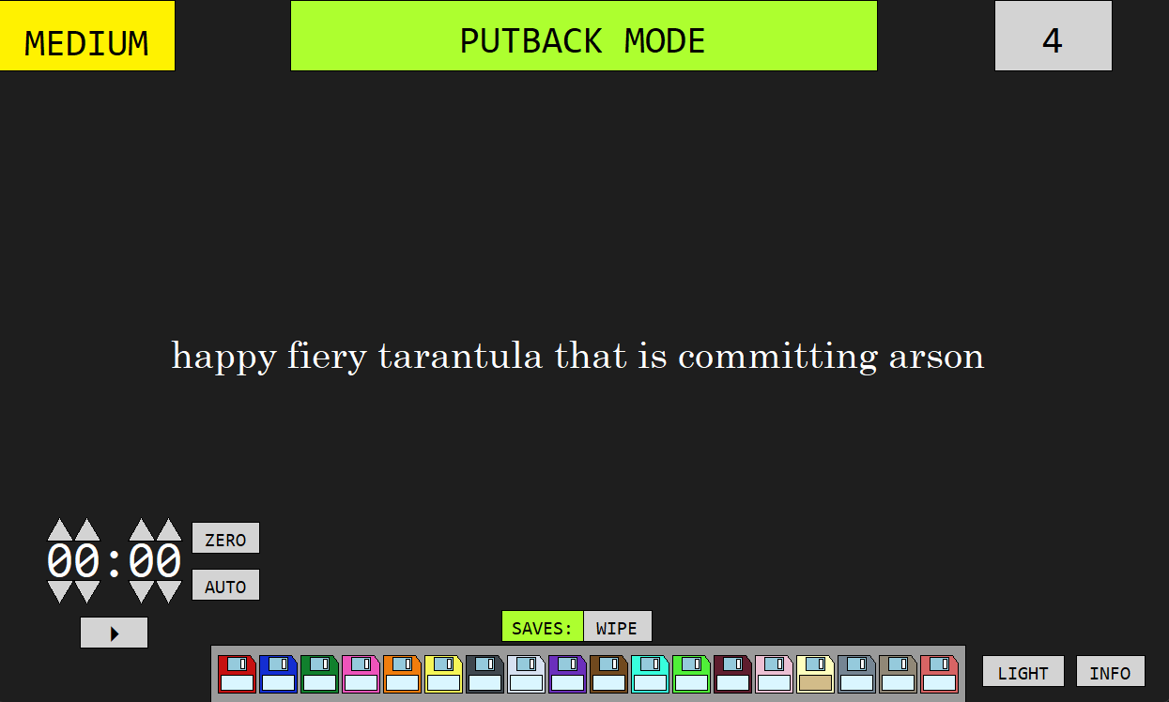
Overview of Project
Game for children
“Phrases” appear on screen
Multiple ways to play
Built with pgl package
Stack and linked list implementations

Slide 4
Process
Implementation of a skeleton frame through PGL
Click actions to interact with the program
Created several files with nouns and adjectives
Created bag with all words
Main program shuffles words when screen is clicked, displays phrase on screen
Created timer with PGL
Remove word from bag

Slide 5
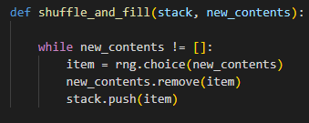
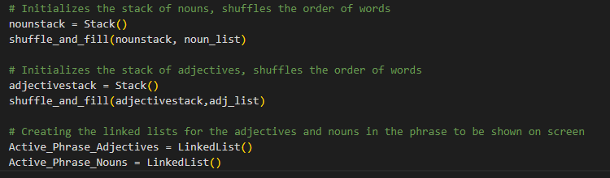
Data Structure Implementation
When the screen is clicked, the phrase is determined by drawing from a stack
Order of the stack is randomly assigned each time the game is played

Slide 6
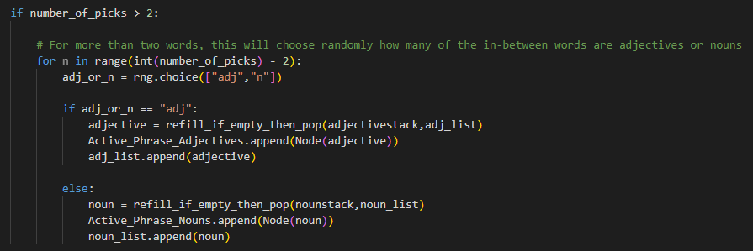
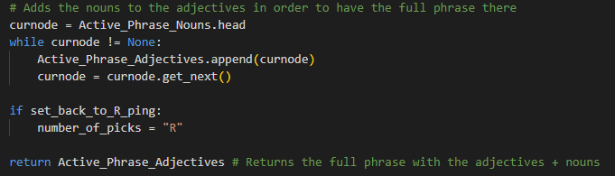
Data Structure Implementation
Pops a adjective + noun from stack, then adds it to a linked lists
The linked lists are combined to form the phrase

Slide 7
Rules / How to Play (Solo Drawing)
Set the timer in the lower left corner.
Click the screen, and a phrase will appear.
Remember your phrase, click again to hide your phrase.
Pass the device to the next person.
Start the timer.
Once the timer is up, try to guess other people’s phrases!

Slide 8
Rules / How to Play (All Play)
Set the timer as before.
Click the screen, and a phrase will appear.
Everyone draws the same phrase.
Whoever’s drawing is the best wins!
Presumably, the winner is determined by vote or something…

Slide 9
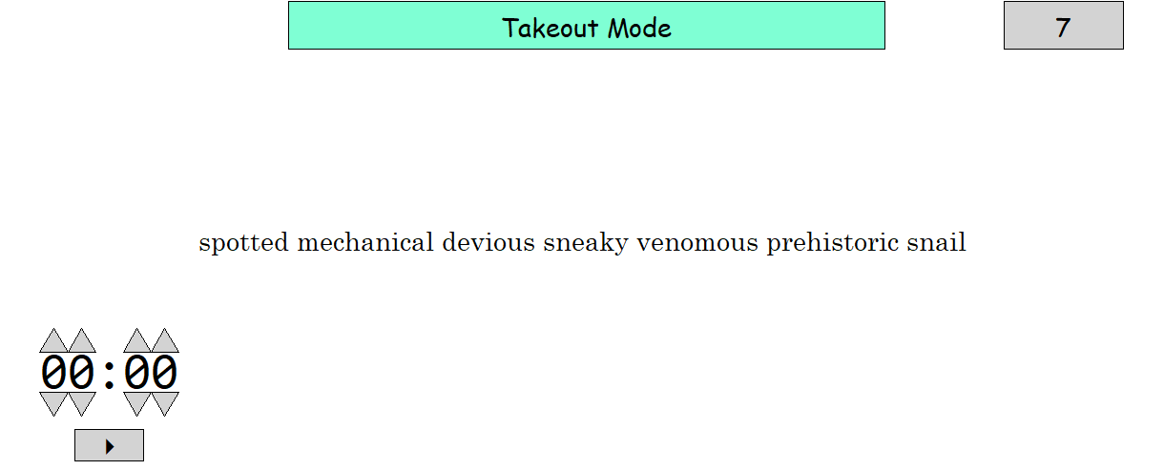
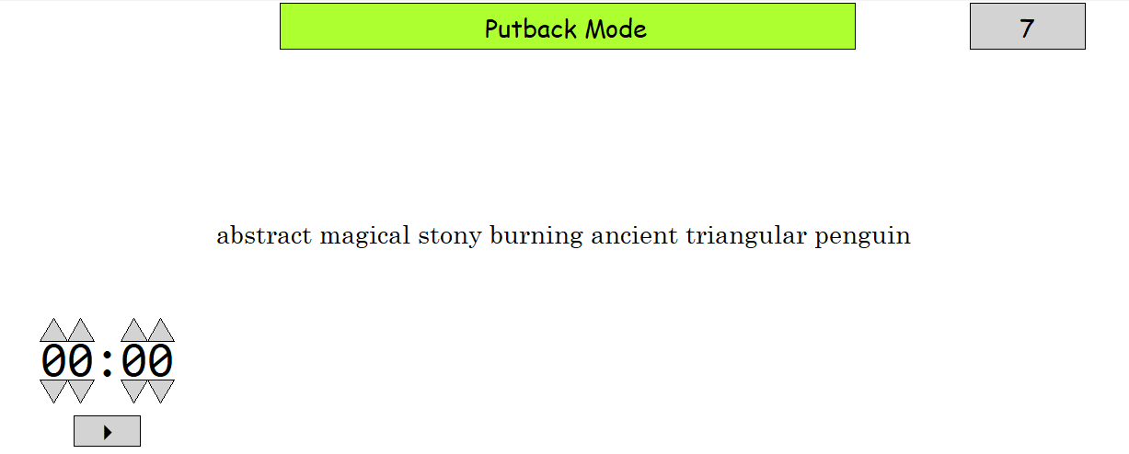

Slide 10
Live Demo (don’t play just show that it works)

Slide 11
Further Work!
Cycle Saved phrases button
Antonym checking/ mutual exclusivity of words
Ex: “icy fiery basking shark shark” is currently possible
More variety
Pressing spacebar == click
Settable automatic time per word
Score-keeping
Take up the whole screen

